Slide 1
OPERATING SYSTEMS AND SYSTEM PROGRAMMING · PBL FINAL REVIEW (REVIEW-3)
FileMind
main.c
Makefile
in history
in history
Intelligent File Access Prediction System
Learns how you open files, predicts the next one, and loads it into memory before you ask.
report.docx
data.csv
in history
predicted next · p = 0.62
Komala Shravya
2510030123
Manugula Sri Harshini
2510030139
notes.txt
slides.pptx
in history
in history
Anil
2510030319
Deekshith Reddy
2510030389
Predict. Prefetch. Perform.
Notes:
Introduce the team and the one-line idea: FileMind watches file access, predicts the next file, and preloads it into the page cache so the open is served from RAM instead of disk.

Slide 2




Every file open still waits on the disk
Higher access time
Traditional (reactive)
Files are fetched from disk only after the user asks for them.
Request
Search
Disk read
Access
Unnecessary disk I/O
The same files are re-read again and again across sessions.
User waits for the disk on every cold open
No learning
FileMind (proactive)
The OS does not learn an individual user's file habits.
Observe
Predict
Prefetch
Access
No look-ahead
Caching is reactive: nothing anticipates the next file.
Predicted file is already in RAM when opened
Notes:
State the problem: OS caching is reactive. The first open of a file in a session goes to disk, and nothing learns which file a user tends to open next.

Slide 3
Related work and existing tools
Work | Approach | What it predicts | Limitation
Linux readahead (kernel) | Detects sequential reads | Next blocks of the same file | Nothing across different files
Griffioen & Appleton, 1994 | Probability graph of file opens | Next file to be opened | Research prototype; fixed thresholds
Kroeger & Long, 2001 | Context modelling of access sequences | Next file sequence | Kernel patch, never mainstream
preload (Esfahbod, 2006) | Markov chain over running programs | Application binaries and libraries | Ignores user documents and data
Windows SuperFetch / SysMain | Usage history of applications | Applications at likely times | Closed source; app-level, not file-level
Gap: existing tools either prefetch within one file (readahead) or predict whole applications (preload, SuperFetch). None learns which user data file a person will open next and prefetches it with a measured hit rate.
Notes:
Walk through each row briefly. The key contrast is preload: it is the closest existing Linux tool, but it predicts programs and shared libraries, not user documents.

Slide 4

What FileMind adds
Capability | Page cache (LRU) | Readahead | preload | FileMind
Acts before the request | No | Yes | Yes | Yes
Predicts the next different file | No | No | Partial | Yes
Targets user data files | No | Partial | No | Yes
Learns per-user habits | No | No | Partial | Yes
Uses sequence and time context | No | No | Partial | Yes
Tracks its own hit rate | No | No | No | Yes
Core novelty
Sequence-aware next-file prediction for user data files, personalised per user.
Prefetching is gated by model confidence (τ) and capped at k files per open, so a wrong guess costs one wasted read, not a slowdown.
Notes:
This answers the question 'how is this different from preload?'. Readahead works inside one file, preload predicts programs; FileMind predicts the next user file and measures how often it is right.

Slide 5
System architecture
ANALYSIS · Python
2 Access History
time-stamped CSV log
3 Pattern Analyser
Pandas: sequences, time
4 Predictor
Markov + scikit-learn
hit / miss feedback
SYSTEM · C / Linux
User / App
opens files
1 Access Monitor
inotify events (C)
5 Prefetcher
posix_fadvise(WILLNEED)
Page cache
RAM
Next open is served from RAM: no disk wait
WILLNEED asks the kernel to load the file into the page cache in the background; the pages stay evictable, so a wrong prediction never blocks the user.
Notes:
Trace one file open end to end: the monitor records it, history and the analyser update, the predictor scores candidates, and the prefetcher issues posix_fadvise WILLNEED for the top prediction. Hits and misses feed back to the predictor.

Slide 6
How the next file is predicted
1
Markov transitions
Example: after opening main.c
Count how often file B follows file A for this user; P(B | A) = count(A→B) / count(A).
Makefile
0.58
2
Context classifier
main.h
0.24
A decision tree (scikit-learn) re-ranks candidates using the hour of day.
notes.txt
0.11
3
Confidence gate
τ = 0.30 → only Makefile is prefetched (illustrative values)
Prefetch at most k = 2 files, and only those with score ≥ τ = 0.30.
Features used
Current file and previous file
Hour of day
Chosen over larger sets (weekday, gap, folder) that predicted worse
4
Online update
Each open updates the counts; the classifier retrains in the background.
Notes:
Explain the two-stage model. The Markov table is cheap and learns quickly; the decision tree adds context such as time of day. The threshold tau keeps wrong prefetches rare.

Slide 7






Built to adapt
Cold start
Changing habits
Multiple users
Falls back to recently used files in the same directory until enough history exists.
Old transitions decay over time, so new routines take over within a few sessions.
Each user runs their own FileMind with their own log and model; no habits leak between users.
Wrong predictions
Low overhead
Portable
Confidence gate τ and at most k files per open; prefetched pages stay evictable.
Monitor in C; a prediction takes about 0.6 ms and runs after the open, never before it.
Standard Linux system calls only (inotify, posix_fadvise, mincore); no kernel patch, no root.
Notes:
Pre-empt likely examiner questions: what happens with no history, when habits change, with several users, and when a prediction is wrong.

Slide 8
How we evaluated FileMind
Workloads
Baselines
Metrics
W1 Coding session: edit, compile, run cycles
W2 Document workflow: reports, data, slides
W3 Random access: stress test with no pattern
B0 Cold cache (caches dropped)
B1 Linux default: page cache + readahead
B2 FileMind prefetching on top of B1
Top-1 and top-3 prediction hit rate
Mean file-open latency (ms)
Disk reads (from /proc/diskstats)
CPU and memory overhead
Procedure Train on 70% of sessions, test on 30%. Files are evicted with posix_fadvise(DONTNEED) to start cold; 80 ms think time between opens; 3 runs, mean reported.
Notes:
Make the evaluation repeatable: same workloads, caches dropped before each run, several runs averaged. W3 is deliberately unpredictable to show how FileMind behaves when there is no pattern.

Slide 9
Results: coding workload (W1)
90%
−69%
67%
Opens served from RAM
Disk reads while waiting
Top-1 hit rate
vs 69% with the Linux default
668 MB → 208 MB vs Linux default
next file predicted correctly; top-3: 96%
W1 metric (mean of 3 runs, 240 opens) | B0 Cold cache | B1 Linux default | B2 FileMind
Opens served from RAM | 0% | 69% | 90%
Mean open + read latency | 4.27 ms | 3.13 ms | 2.77 ms
Disk reads on user's path | 2278 MB | 668 MB | 208 MB
Prediction time / model size | n/a | n/a | 0.58 ms / 2.2 KB
Measured on a Linux 6.18.44 cloud VM with a very fast virtual disk, so the latency gain (−11%) is understated; on a laptop SSD or HDD the gap is larger.
Notes:
These numbers come from bench/benchmark.py. Best practice: re-run ./run_all.sh on your own laptop before the review and rebuild this slide with those numbers. Lead with residency and disk reads: they do not depend on disk speed.

Slide 10
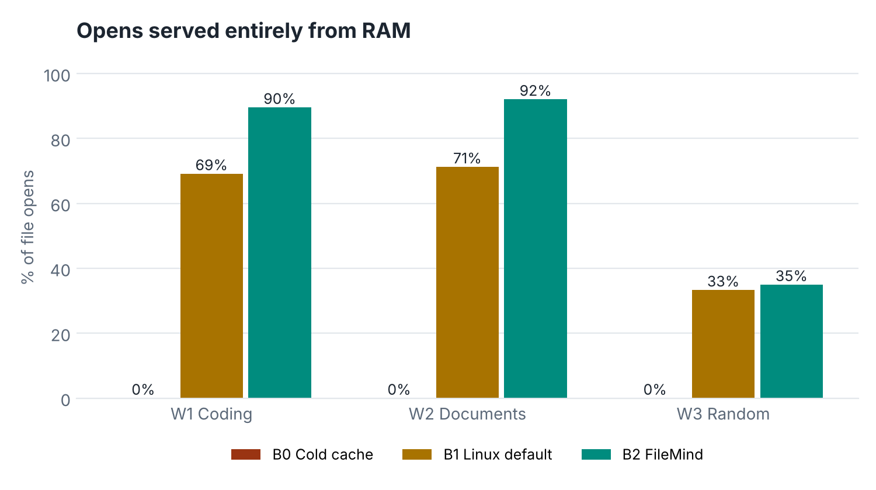
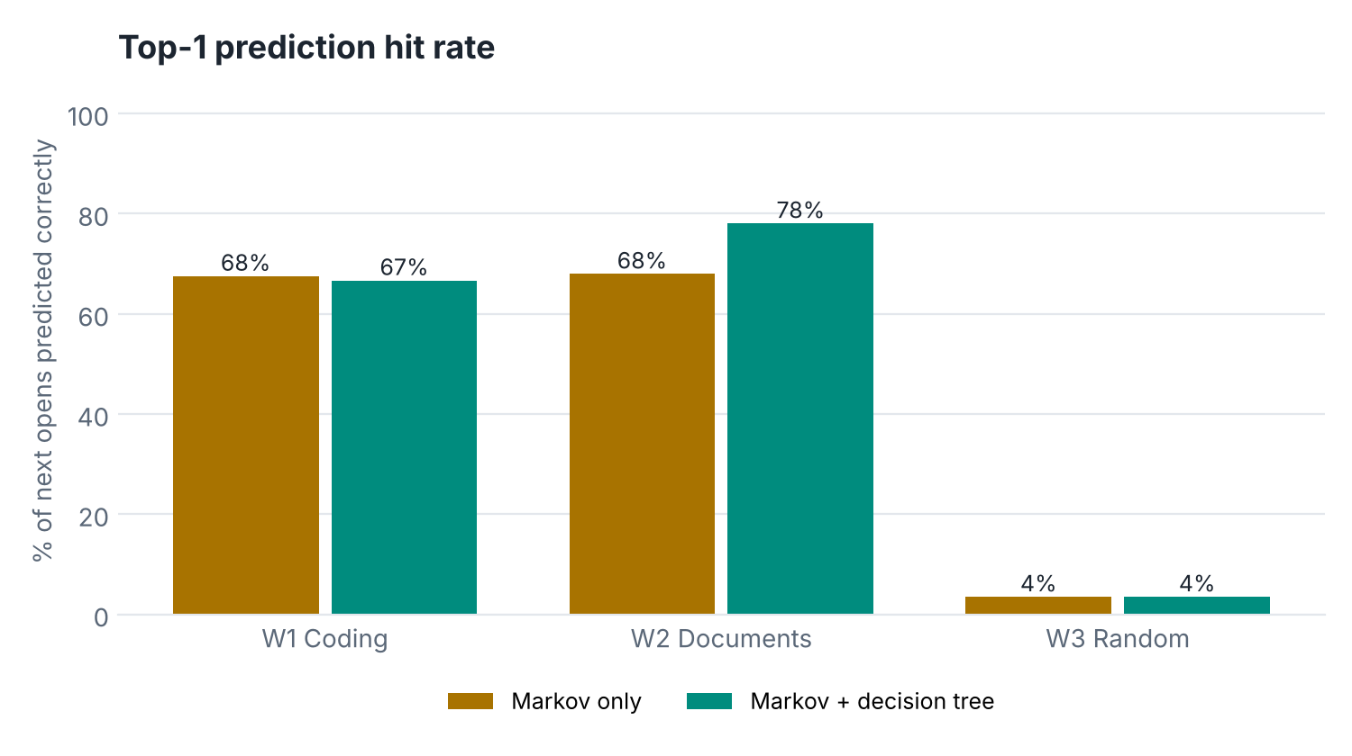
Results across all three workloads
Patterned work benefits most
W1 and W2: 69–71% → 90–92% of opens served from RAM.
The decision tree earns its place
In W2 the next step depends on the time of day: Markov only 68% → with the tree 78%.
Stays out of the way on random access
W3 has no pattern (hit rate 4%); the confidence gate keeps prefetching low.
Notes:
Left: share of opens that found the file already in RAM. Right: top-1 hit rate, Markov-only vs Markov + decision tree (ablation). Point out W3 honestly: no pattern, so FileMind does almost nothing, which is the correct behaviour.

Slide 11


Limitations and future work
Where it struggles
Next steps
Random or one-off access (W3) gives little to predict
First session for a new user starts with an empty model
Wrong guesses waste disk bandwidth (~950 MB of 2.6 GB prefetched in W1)
Benefit is small on fast NVMe drives with warm caches
eBPF-based monitoring for lower capture overhead
Sequence models (e.g. LSTM) for longer access patterns
Adaptive threshold τ tuned from live hit rate
Desktop integration: prefetch at login and app launch
Takeaway FileMind helps most on repetitive workflows (W1, W2); on random access it should simply stay out of the way.
Notes:
Being upfront about limitations scores well in evaluation. Tie each limitation to a next step where possible.

Slide 12

Code and live demo
Source code
C: access monitor (inotify) and prefetcher (posix_fadvise)
Python: Markov + decision-tree predictor, live daemon
Benchmark: 3 workloads × 3 baselines, charts and tables
github.com/sr1-harsh/filemind
README with build, demo and benchmark steps
Run it yourself (Ubuntu or WSL2)
$ make && python3 bench/gen_workload.py # build C tools, create demo workspace
$ python3 -m filemind.daemon --watch workspace # live: predict + prefetch
$ ./demo/demo_session.sh # (2nd terminal) simulated user
$ ./run_all.sh # full benchmark + charts
Notes:
Run the live demo here: daemon in one terminal, demo/demo_session.sh in the other. Then demo/compare_open.py to show one file opening cold vs prefetched.

Slide 13
Conclusion
01
02
03
Reactive to proactive
Measured, not assumed
Cheap when wrong
FileMind turns file access from wait-then-read into predict-then-prefetch.
Up to 92% of opens served from RAM and −69% disk reads vs the Linux default.
Confidence gating and evictable prefetches keep the cost of a miss small.
Predict. Prefetch. Perform.
Notes:
Close on the three takeaways. Quote your headline number here once results are filled in, e.g. 'X% of opens were served from RAM'.

Slide 14
References
J. Griffioen and R. Appleton, "Reducing File System Latency using a Predictive Approach," Proc. USENIX Summer Technical Conference, 1994.
T. M. Kroeger and D. D. E. Long, "Design and Implementation of a Predictive File Prefetching Algorithm," Proc. USENIX Annual Technical Conference, 2001.
B. Esfahbod, "Preload: An Adaptive Prefetching Daemon," M.Sc. thesis, University of Toronto, 2006.
Linux man-pages: inotify(7), posix_fadvise(2), mincore(2), readahead(2).
F. Pedregosa et al., "Scikit-learn: Machine Learning in Python," Journal of Machine Learning Research, 12, 2011.
Notes:
References for the related-work slide and the main APIs used.

Slide 15
Thank you
Questions?
Komala Shravya · 2510030123
Manugula Sri Harshini · 2510030139
Anil · 2510030319
Deekshith Reddy · 2510030389
Code and demo
github.com/sr1-harsh/filemind
Notes:
Invite questions. Keep the repo link on screen.

